Slide 1



Cadette Amaze Journey
Part1

Slide 2
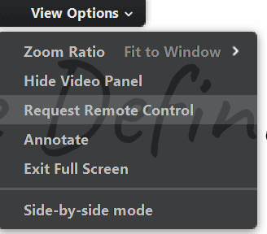
How will this Virtual Troop Meeting Work?
On bottom of your screen, there is a control panel. You should see a microphone, a video camera and a chat bubble.
When asked to speak, click on your microphone so it is green. Then everyone will be able to hear you.
If you have a webcam, clicking on it will let everyone else in the meeting see you too.
The Chat Log looks like a cartoon thought bubble. You can type questions or comments into the chat log and everyone will be able to see what you write!
          At the top of your screen is “View Options.” We will be using the “Annotate” option throughout this journey. Please only use this feature when asked.
          There may be a pen icon at the bottom of your screen for the annotation tools.
Notes:
And keep in mind…

Slide 3
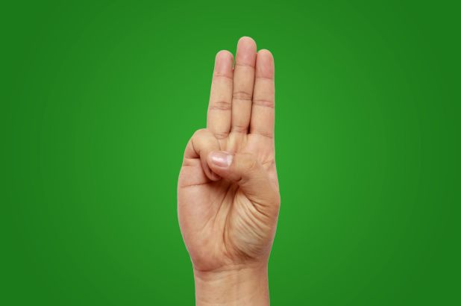
Girl Scout Promise & Law
Girl Scout Promise
On my honor,
I will try, to serve God,
and my country, to help people at all times,
and to live by the Girl Scout Law.
Girl Scout Law
I will do my best,
to be honest and fair,
friendly and helpful,
considerate and caring,
courageous and strong,
responsible for what I say and do,
to respect myself and others,
respect authority,
use resources wisely,
make the world a better place and
be a sister to every Girl Scout.

Slide 4

Cadette Amaze Journey
This journey has three parts or awards.
Award 1. Interact – The ins and outs of people.
Award 2. Peacemaker – A toolkit
Award 3. Diplomat – Your Take Action Project
To finish the journey you will be required to complete a Take Action Project. The details will be discussed in Award 3 and additional materials will be provided in the post workshop email.

Slide 5
A word about journeys.
A journey cannot be a simple presentation.
We want you to be interactive and hear your voice. Sharing and learning from each other is the only way to learn from a journey.
Put your best Girl Scout foot forward and be brave. Have the confidence to share a little of yourself in this SAFE environment.
No one will bully you. No one will say that answer is stupid. And no one will think less of you if you stumble over the words.
We ALL promise to follow the Promise and Law and to act with Confidence, Courage and Character. We are sisters!

Slide 6
Team Agreement
With any journey, it is important to know who you can trust and the basic ground rules. What do we need to promise each other to ensure a positive experience?
Notes:
Suggestions: Watch our body language (No eye rolling).
If we have a disagreement with someone in the group, we can..
If we have a difference of opinion, we can…
Capture the comments for use later.

Slide 7
Introductions
Be brave and unmute.
Tell us something about yourself!
Notes:
Ask the girls to tell us their first names, where they are from and one thing we won’t be able to tell about her from what we see now.

Slide 8
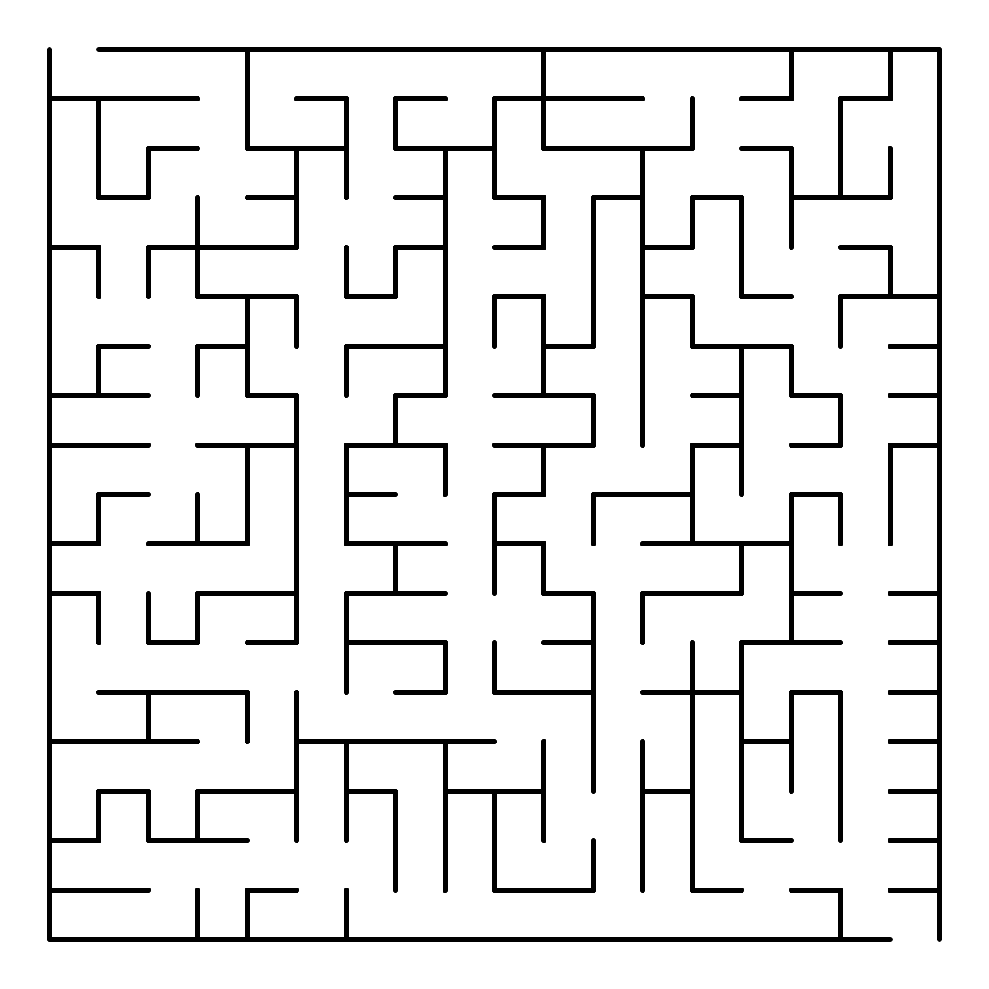
Use the annotation tool at the top of your screen. DRAW your way through the maze. Feel free to change the color.
Notes:
Explain how the annotation tool works and that they should use the draw feature.

Slide 9
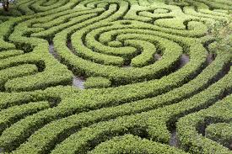
Our lives are like mazes.
A simple statement but think about how your life is like a maze and you will find complexities that intertwine and connect many ways.
Think about these questions and write two questions down in your notebook. Now write your answer. Be prepared to share one.

Slide 10
What does a friend do that helps?
Where do new friends fit in your maze?
What new things might get added to your maze over the next few years?
Where do you sit at lunch?
Did something hurt your feelings?
How do you help your friends?
Have you defended a friend from a Bully?
What do you talk about online?
Who doesn't sit with you at lunch?
Who are the adults that help you?
There are 4 polls with these questions.
Notes:
Present the list of questions first and remind them to pick 2 to write and answer.
Present the polls one at a time for the following questions.
Are you ever a Bully?
How do Bullies affect you?
Ever have a conflict with a friend?
Did you ever confide in a trusted adult?

Slide 11
Hana
In your notebook make a circle in the center of the page by tracing a quarter. Write your name in the circle.
Draw a bigger circle almost as big as the page. Add the names of your close friends inside the bigger circle.
Add the names of your trusted adults.
Add the names of other friends and family outside of the circle but on only one side.
Only add positive names.
Tom
Mom
Brian
JP
Kim
Bailey
Piper
MarieME
Jen
Nancy
Judy
Brittney
Alyce
Carin
Dad
Amanda

Slide 12
Gone
Hana
Moved away
Using a different color add in the names of people that are a negative factor in your maze on the opposite side.
You can add things and places that affect your maze and feelings.
Use a third color to write why these negatives affect you and your maze.
Now think about how you could fix these negatives.
Tom
Illness
Mom
Brian
No contact with friends
JP
Jen
Hailey
Bailey
Piper
Bully
MarieME
Kim
Marcie
Bully
Nancy
Judy
Grace
Brittney
Nancy’s friend
Alyce
Dad
Carin
After school
Lonely
Amanda
Jane
Her friend, not mine
Crazy
Notes:
Identifying an issue is the first step to change. Nancy and Marie are friends. Grace and Nancy are friends too. Marie and Grace are not friends. Marie wants to go to the movies with Nancy but can’t because Nancy has plans to do something with Grace. Marie is sad because she wants to spend more time with her friend. What can she do? What other negatives can you change?

Slide 13
We’ve been looking at how our lives are like mazes with all the twists, turns and unexpected changes. Just like our relationships. And even though most mazes have one true path, navigating life doesn't have to be a one-size-fits-all solution. You can confront obstacles, try shortcuts and take chances as you try to find the right way.
Along the path of this Amaze journey, we’ll explore how to have the best and healthiest relationships. We will learn skills to build confidence to navigate all relationships.
Notes:
Ask the girls to look at the photo. Have them read the good words. How about the not so good words.

Slide 14
Peacemaker Toolkit
Along our journey you will be building your Peacemaker toolkit. Little tips and tricks learned along the way. Feel free to add anything that YOU feel is important.
As we go along, we will tell you to add that to your Peacemaker kit.

Slide 15
First Impressions
55% of 1st expressions are based on appearance.
Research studies show that a person starts to form impressions of a person after seeing their face for less than one-tenth of a second. In that time, we decide whether or not the person is attractive, trustworthy, competent, shy or dominant. Most impressions happen in 7 seconds.
How you present yourself can make the difference in how people will react to or accepting you. First impressions are frequently wrong.
40% of 1st expressions are based on voice & speech.
5% of 1st expressions are based on what is said.
Notes:
Ask if they ever made the wrong first impression about someone? Are they now friends?

Slide 16
The Power of First Impressions
You can’t tell how a person is on the inside from what you see on the outside.
Potential friendships are sometimes stopped in their tracks because of first impressions.
Our minds often make split-second decisions. These instinctive spontaneous reactions often stem from our experiences, training and knowledge. They also come from ingrained biases and prejudices.
A gut reaction can be very useful, especially in times of danger. But when it comes to giving someone a chance, it’s best to go beyond your gut.
First impressions can hurt you and the other person.
First impressions affect how people are treated.

Slide 17
Stereotypes
What is a stereotype?
A stereotype is a mistaken idea or belief many people have about a thing or group that is based upon how they look on the outside, which may be untrue or only partly true.
Such as “Dumb Blonde.” Does our hair color tell our personality?

Slide 18
What does prejudice mean?
Prejudice
Prejudice means preconceived opinion that is not based on reason or actual experience.
Someone may decide they do not like them because of their skin color ("racial prejudice"), religion (religious prejudice) or nationality. Such prejudices can lead to discrimination, hatred or even war.

Slide 19
Girls can’t do math.
Girls like pink and boys like blue.
Only boys can play sports.
Boys play with trucks and robots.
All Arabs and Muslims are terrorists.
Video games are for boys.
Blondes are dumb
Blacks are not as smart as whites.
Mexicans are illegals.
Cops like donuts.
Women should be skinny.
Men who wear pink are gay.
Librarians are old women who wear glasses and a hair bun.
Notes:
Ask how they feel about each phrase. Click through examples.

Slide 20

The Power of Belonging
Can you share a time when you wanted to belong to a group?
Have you ever traded off any values to belong to a group? If so, which ones?
What do you think contributes to giving in to pressure to belong?
What does being self-confident mean to you?
What common values do we share as a BFF group?
Notes:
Say: Everyone wants that powerful feeling of belonging. Being connected to others confirms that we matter. And that’s a human need! Sometimes we want that belonging so badly that we think it won’t matter if we trade our values for popularity. For example, lying to your parents about where you went after school or posting an unattractive picture of the new girl online because someone dared you to. But small trade-offs add up, chipping away at our sense of who we are and what is right. When those things become blurry, you may find yourself caving in to peer pressure more and more.

Slide 21
See you tomorrow for part 2!
As you go about your life until we meet again, please think about the maze and how you are traveling through it. Write any thoughts down in your journal. Did you have a conversation with someone inside your circle? Did you hear a story about someone outside your circle?
We will have time saved for anyone that wants to share.
Thank you for sharing your time with us today!

